Slide 1
Write ontology → check consistency; constraints → translate to modelica

Slide 2
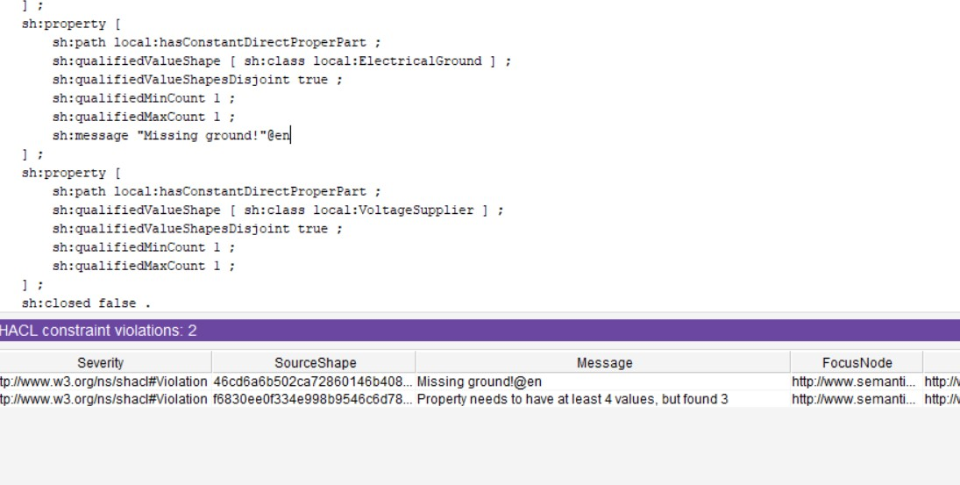
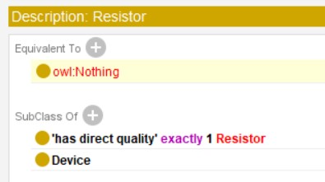
Write ontology → make error →(a) write something wrong -- inconsistency or (b) don’t write something correct -- constraint violation
Example of (a)
Declared that a resistor has
a restistor (in place of resistance, a
misnomer) quality → Inconsistency
Example of (a)
Declared that a resistor has
a restistor (in place of resistance, a
misnomer) quality → Inconsistency
Example of (b)
No ground in a circuit → constraint violation

Slide 3
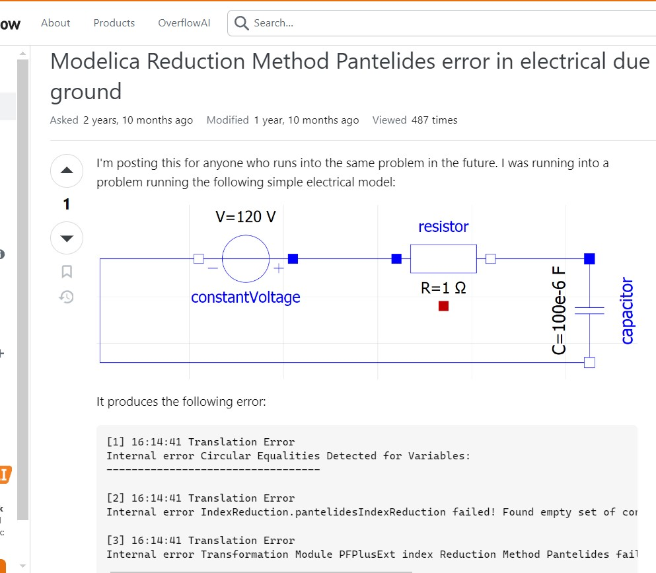
Both types of error not so trivial to debug: misnomer could be difficult to find; missing element requires domain+modelica knowledge
I wasn’t the first to forget a ground...

Slide 4
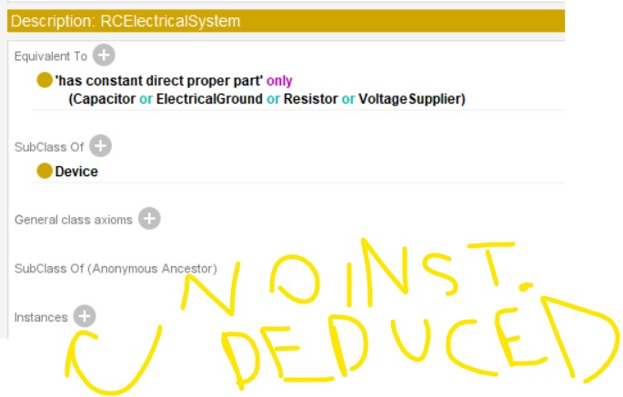
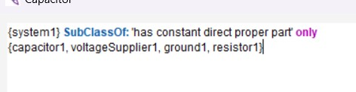
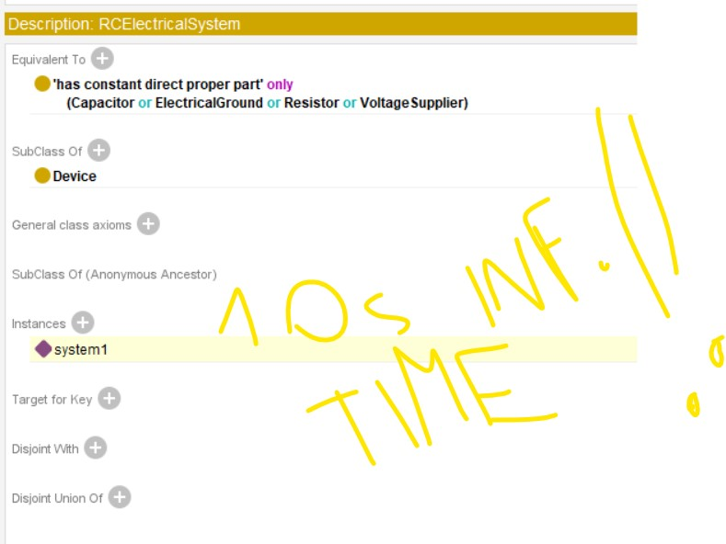
Limits of reasoning: open world behavior difficult to deal with:
Try to define RC circuit is possible but (a) easy not to get
expected result: doing it correctly requires instance-level
closure statement (b) which makes reasoning super-slow! (d)

Slide 5
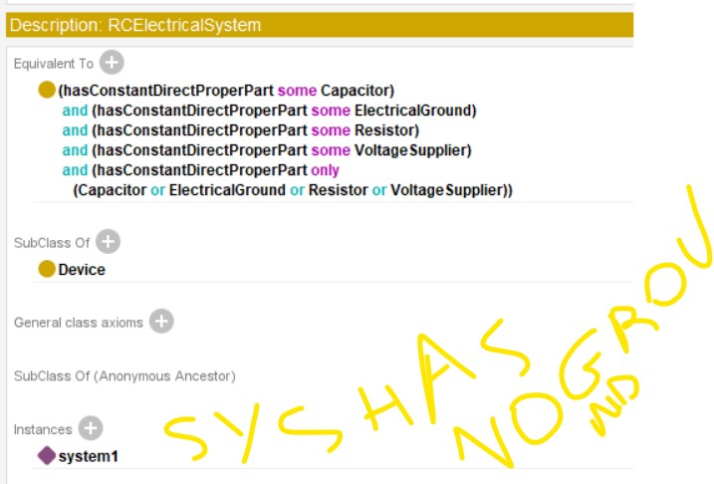
Limits of reasoning: open world behavior difficult to deal with:
Moreover, trying the opposite (declaring an entity as an
instance of a class with some properties) does not
entail that the class-characteristics are instantiated nor
checked. This requires a constraints language.

Slide 6
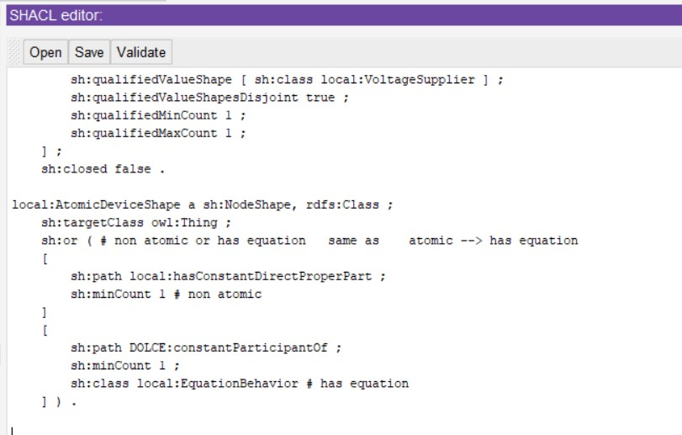
Constraint language: cardinalities, rules, etc.
If a device is atomic then check if it has
an “equation behavior”
An RC system must have, at least 1 resistor
component, at least 1 ground component, etc.

Slide 7
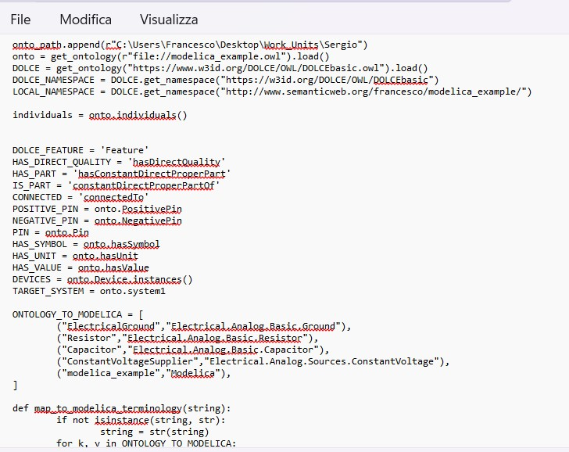
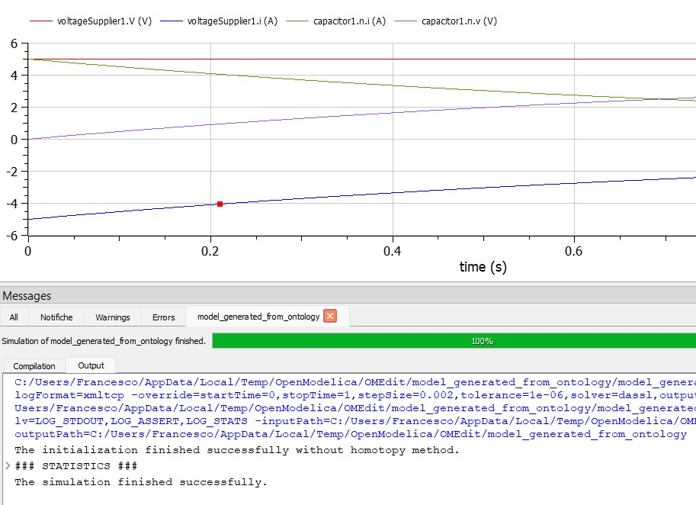
After consistency and checking translation
Simple translation sofware (c.a. 100 lines)
produces compilable modelica model.
However, it requires terminological mapping
between ontology and modelica things

Slide 8
Instead of
Write ontology → check consistency; constraints → translate to modelica
better?
Write modelica → translate to ontology → check consistency; constraints → translate to modelica
Technology stacks, from OMG to SemWeb/Python, how to interoperate?
(e.g. EGL + EGX + Emfatic + Flexmi to Modelica code vs Python to Modelica)

Slide 9
Modelica Ontology
Modelica is a language for simulations of certain physical phenomena.
Indeed, it is a formal language with BN-style grammar specification
I consider it the modelica ontology, with its own language

Slide 10
Modelica Ontologies
There exist two other modelica ontologies:
  MoOnt
  The openmodelica ontology (I translated it manually from OMLv2 to OWL)

Slide 11
Main properties of the Modelica Ontology
The modelica ontology has various charachteristics, mainly inspired from Obj.Or.Programming and from the simulation domain.
The key ones are discussed briefly in the oncoming slides, especially their mapping to a logical-style language

Slide 12
Class
A class can be instantiated → Class=Predicate
with instantiation = predication
An abstract (partial) class can not be instantiated (directly) → Partial Class C ==>
forall x (C(x) ==> exists S (S < C and S(x)))
A class can extend other classes → C extends P ==> C < P i.e. C(x) ==> P(x) and C != P

Slide 13
Class and Instances (!)
What is an instance in Modelica? Unclear!
Is it any x found in e.g. “MyClass x”?
→ It is not important. Important is flattening procedure, Flattening != Instantiation.
A flattened model is simulated, not an instantiated model

Slide 14
Class vs Type
There was some discussion about distinguish “the creation of [something] and its definition” e.g. a FU_Port must be defined by a FlowUnit.
Analysis of library shows:
partial connector FU_Port extends DataPort;
replaceable DataStructures.FlowUnit flowUnit;
end FU_Port;
So it seems it references the type of thing that flows in the port==> to be discussed how to treat it. (eg reif.role part-of thing and with that type, or role-class subclass-of type)

Slide 15
Class vs Data-Type Class
Some modelica specialized classes are datatype classes. To be checked if this could become relevant in the translation in OWL, if needed.

Slide 16
Aggregation
Components are
“An element defined by the production component_clause in the Modelica grammar (basically a variable or an instance of a class)” i.e. anything
Summary analysis suggests they are either qualities (variables, parameters), regions (constants), object-parts (model in a model), roles (flow, stream, in/out).

Slide 17
Specialized Classes
Note that “type” is a “specialized class” (a class related to the simulation domain). It means data-type. I deduce that “has-type” (x is a variable of type Real) is instatiation (modulo the difference between a quality and its value)
model M
Real v; ==> every M has a v, which is end M; a quality whose values are real values.
v identifies the role that quality plays in the beh. of an M, it is not a type, nor an individual

Slide 18
Specialized Classes 2
Are specialized Classes and user-defined classes of the same nature?
I say yes, despite enjoying a different syntax
model M
Real v; ==> M < model < Thing end M; Real(v), Real<type<Thing

Slide 19
Other ontologies rejected
OpenModelica ontology considers class extension a token-level property. For this (among others) reason I reject its use
MoOnt is better, but has various ideosynchrasies (e.g. ModelicaClass > MabstractClass > Mclass) and moreover poor documentation (explained how it was developed but not e.g. what MComponent is), and things not in Modelica (e.g. hasPart).

Slide 20
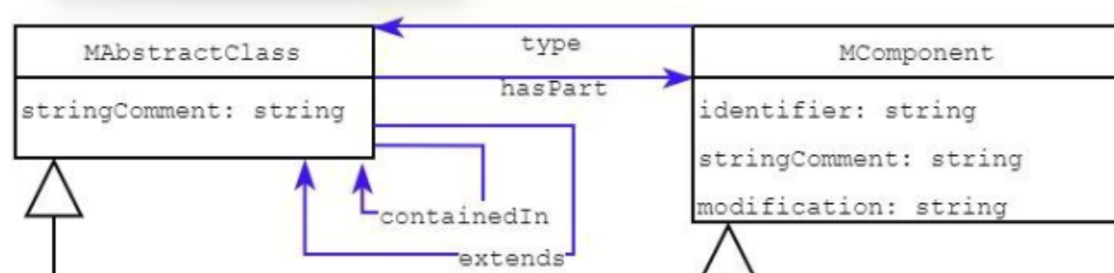
In passing, this is correct if the arrows are intended to be class-level relations. However MoOnt considers them object properties

Slide 21
Therefore the only modelica ontology I use is modelica itself.
Packages can then be specified in Modelica and be mapped to Logic-style ontologies by means of the mapping discussed before

Slide 22
SHACL
Two open source (from OntoText and Web Semantics Oviedo) tools for conversion from/to compact shacl/shex syntax.
Both broken and abandoned ages ago ofc…
So you are stuck with un-human-like syntax

Slide 23
Consider abolish constraint-focused modelica classes such as one/twoPortModel and delegate their semantic to constraints
Isn’t it a problem that OnePortModel has a port1 component and TwoPortModel has a component with the same name?
Renamed ProductSim → Product_sim for coherence

